Slide 1
BA - Final Project
File created on: 1/20/2026 12:23:38 AM

Slide 2


Slide 3
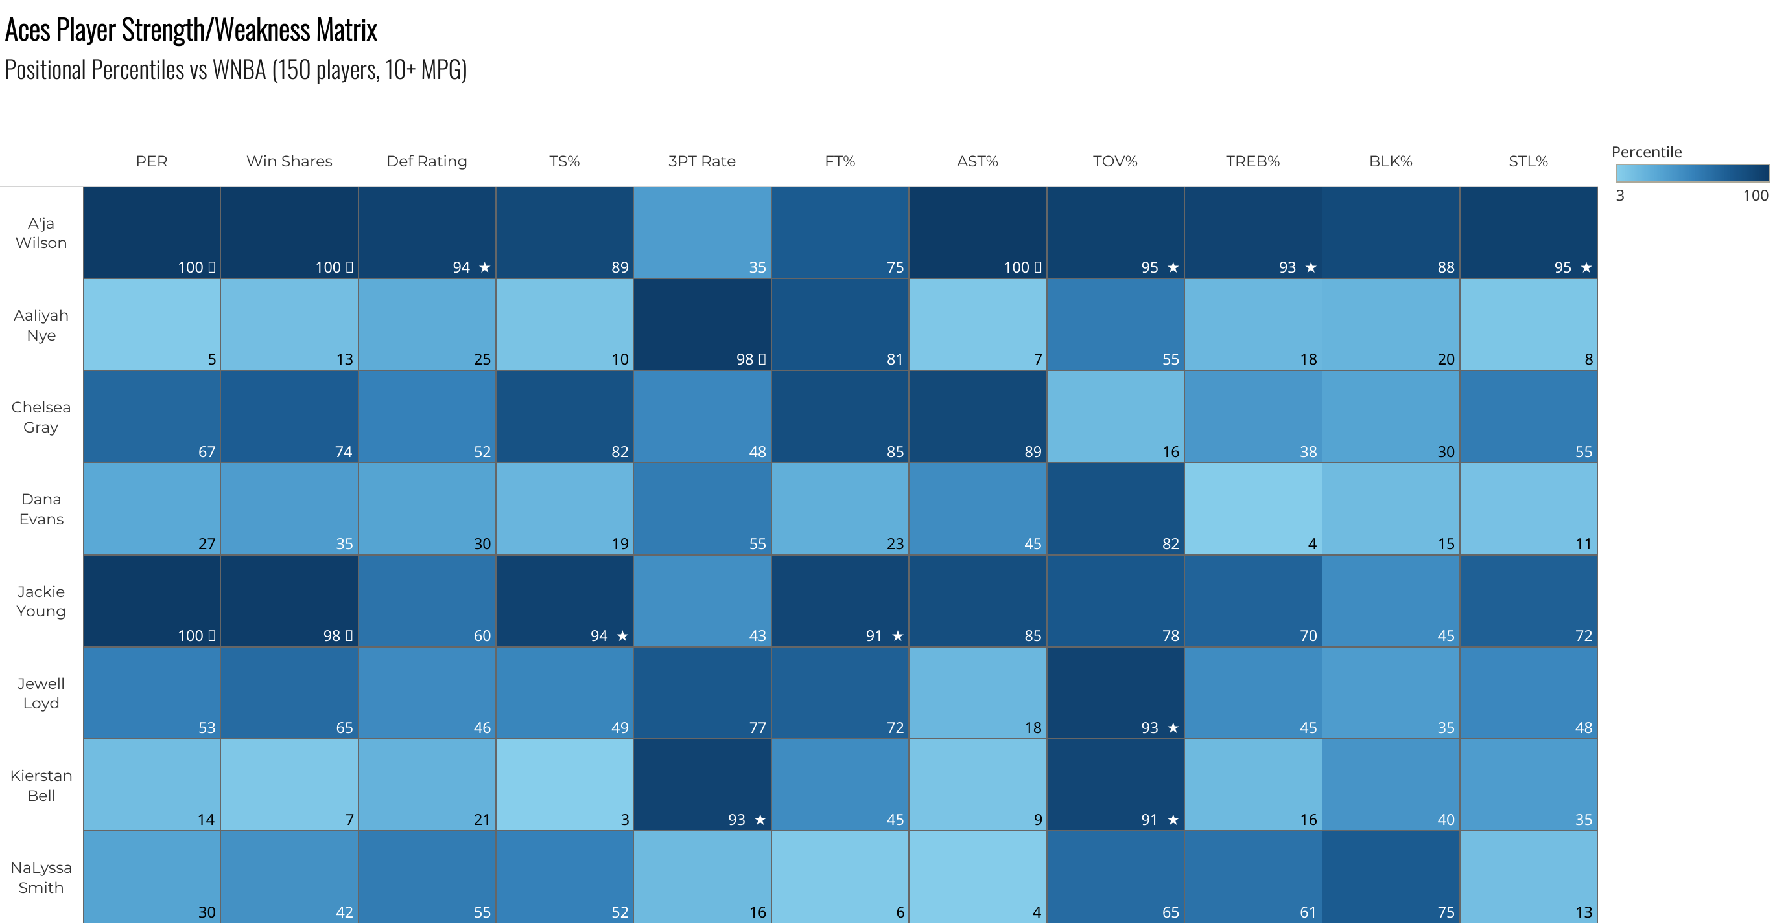

Slide 4
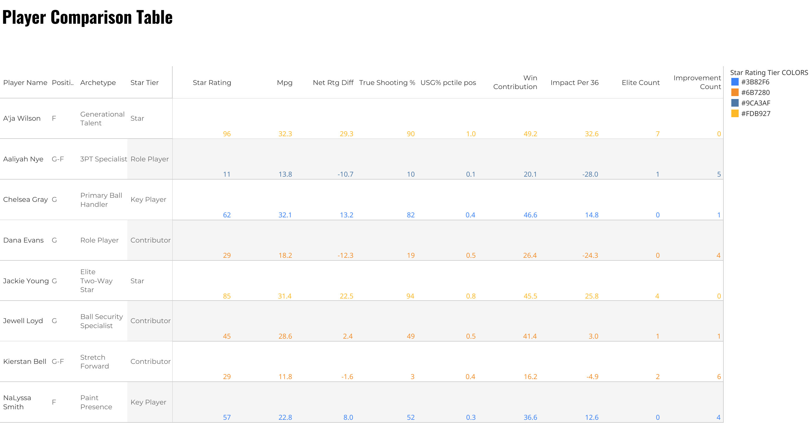

Slide 5
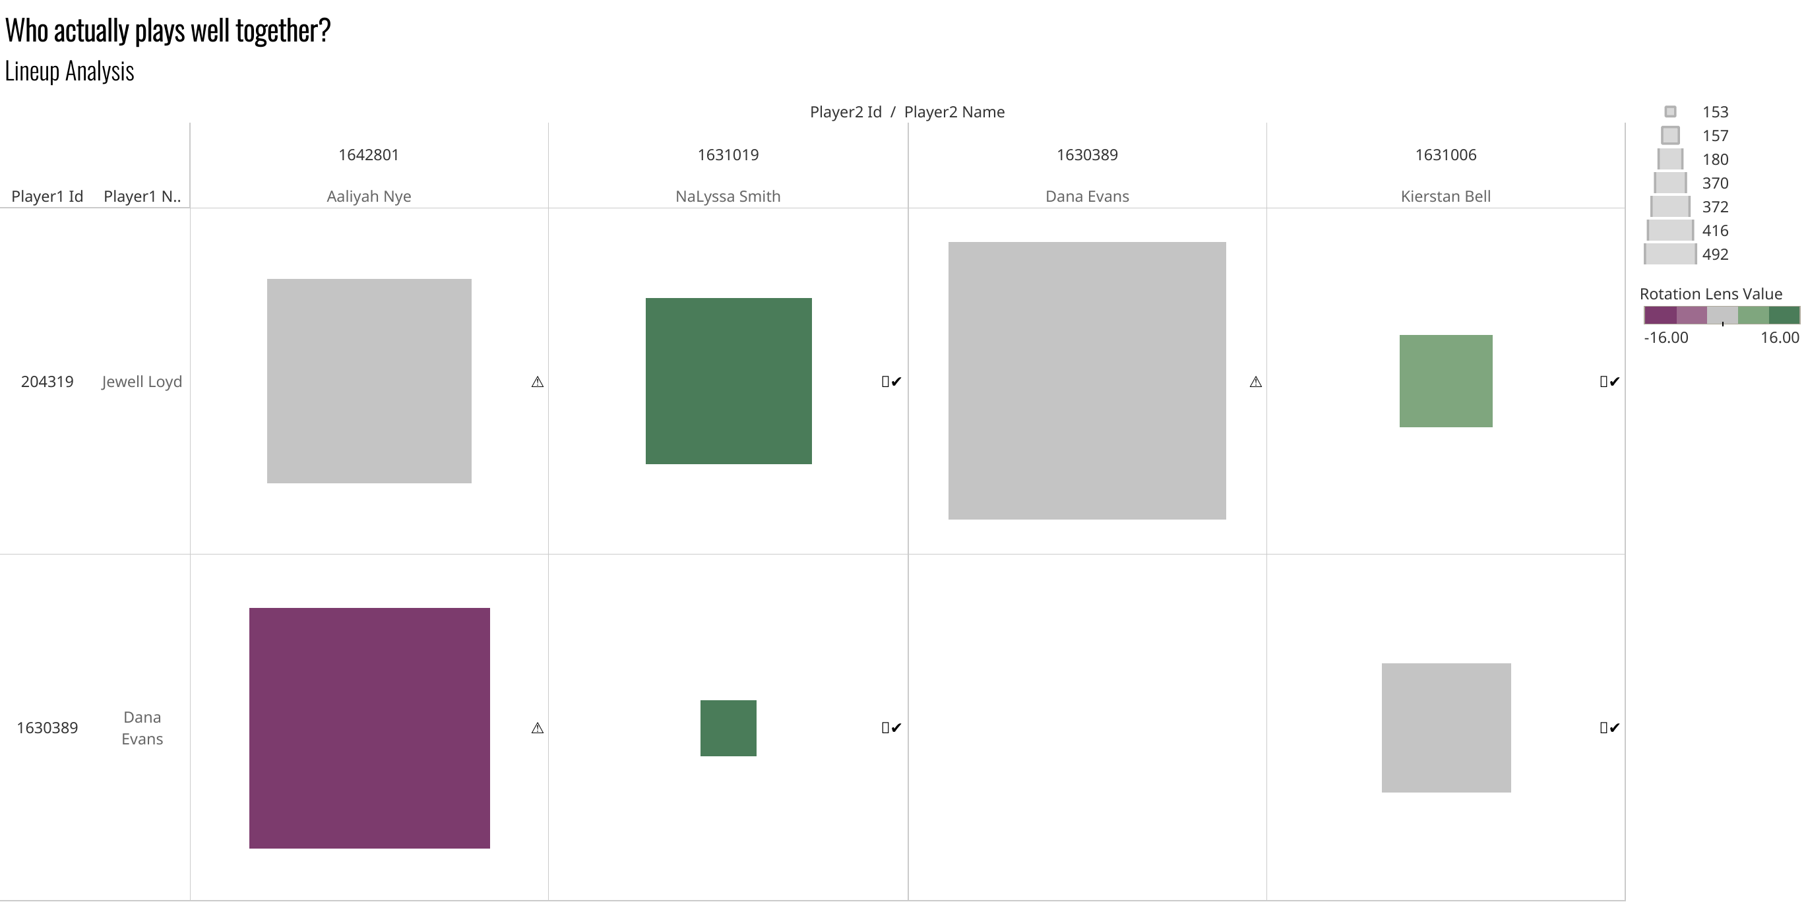

Slide 6
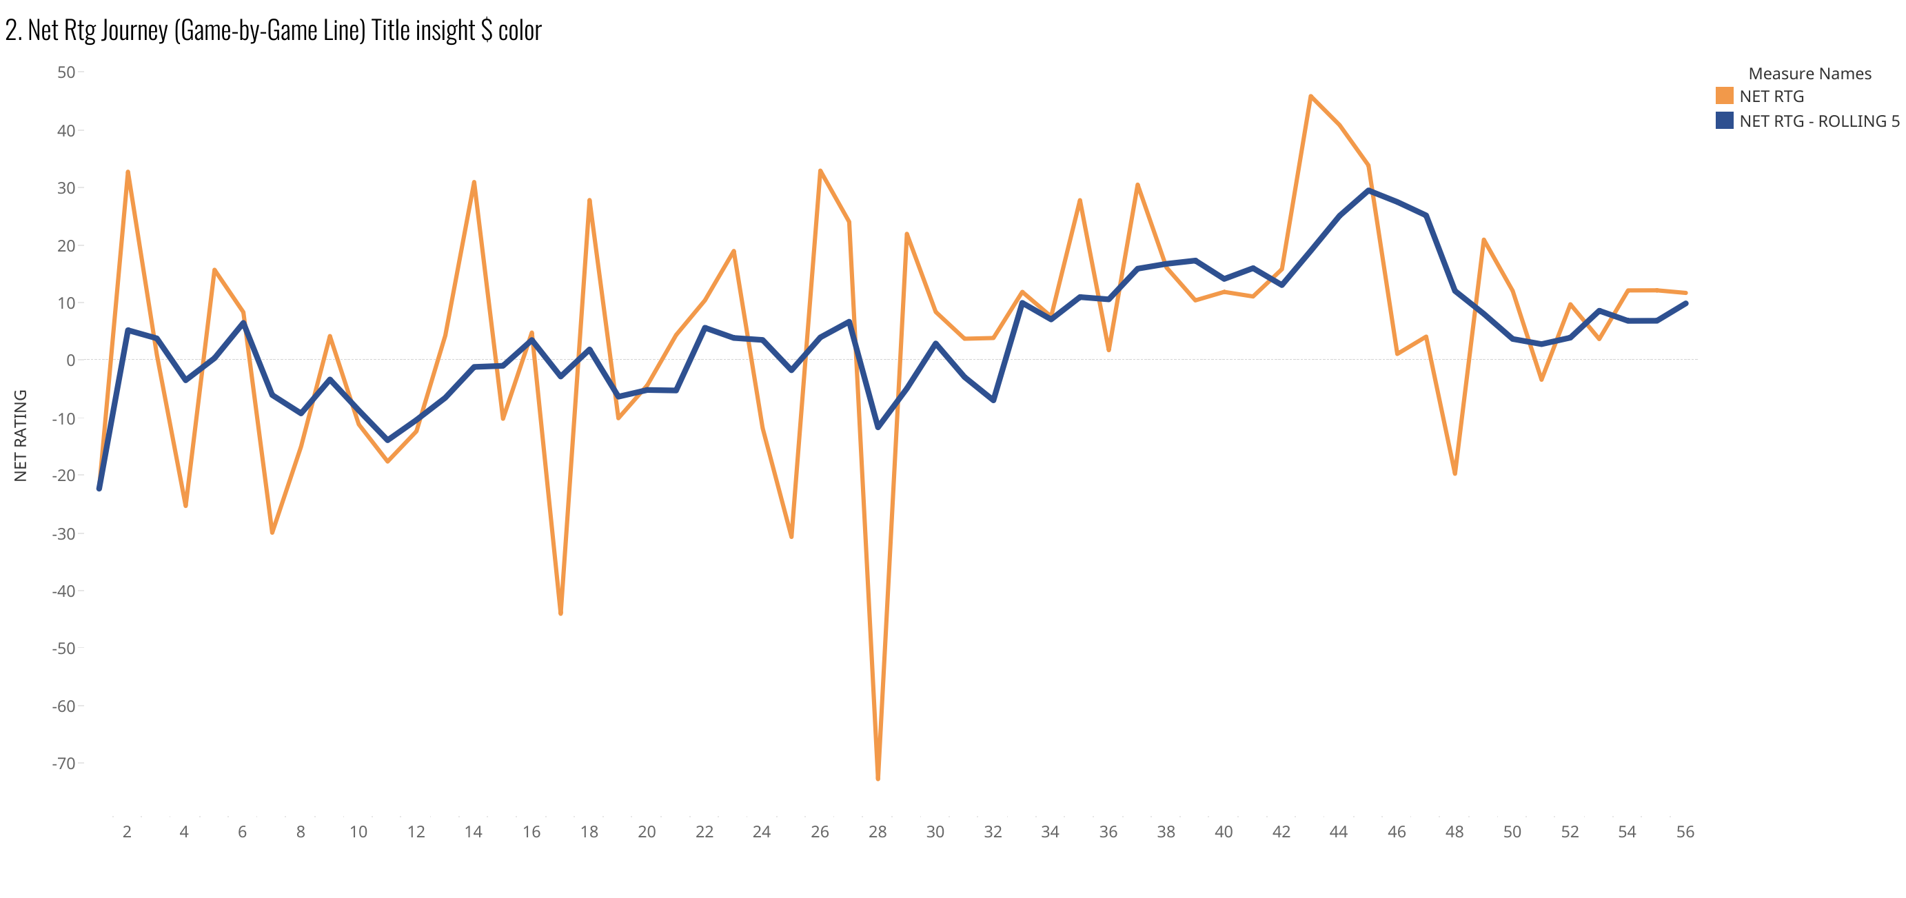

Slide 7
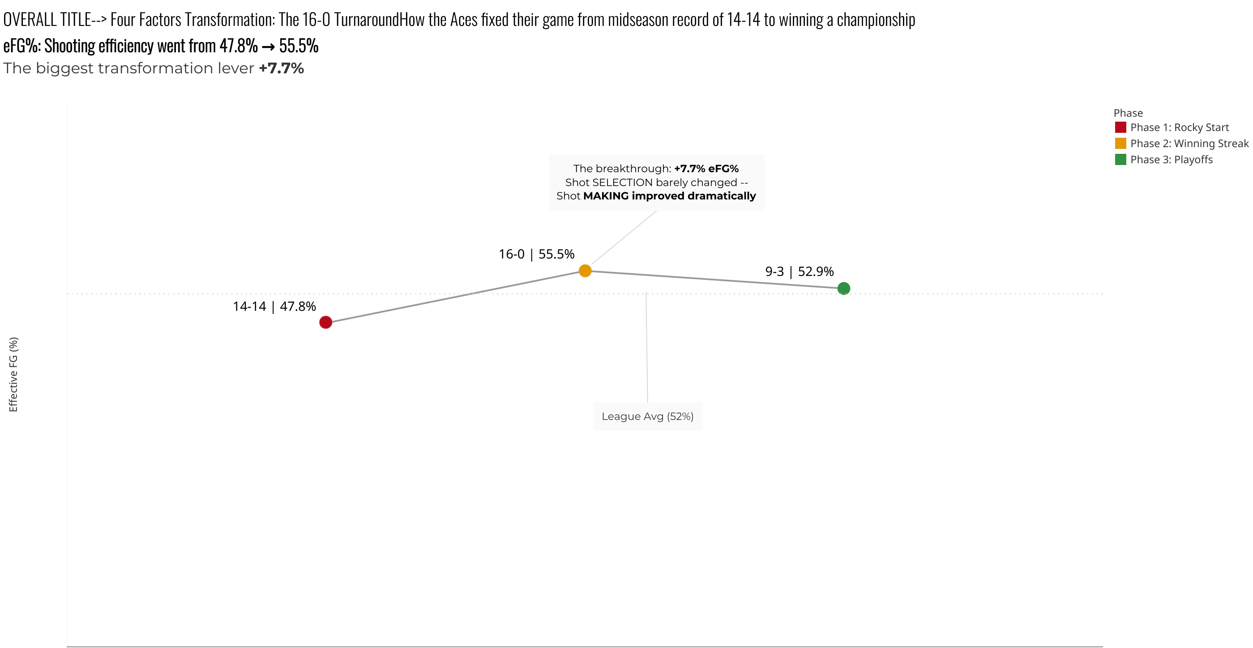

Slide 8
